Slide 1
Computer Graphics
Day V

Slide 2
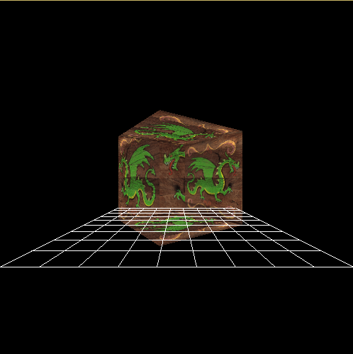


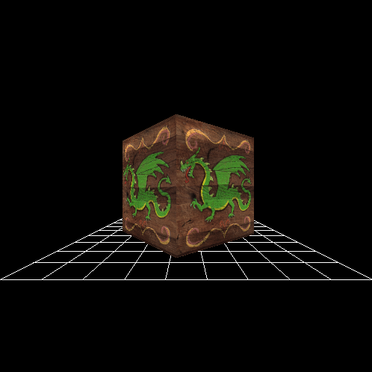
Sorting Primitive Data
NOT SORTED
Now that we can draw shapes in 3D a problem arises...
If we continue to draw shapes in any order we please, our scene will look incorrect.
SORTED BY Z

Slide 3
The Painter’s Algorithm

Slide 4
Sorting your primitives by distance
Pros
Cons
Simple idea, easy to understand.
Easy to implement in a naïve way.
No extra memory required.
Once sorted you could use insertion sort for new items.
Naïve implementation processing cost scales exponentially.
Moving the camera requires a full re-sort.
Poor solution for highly dynamic scenes.
Not Robust. Fails certain edge cases.
Requires polygon splitting for edge cases.

Slide 5
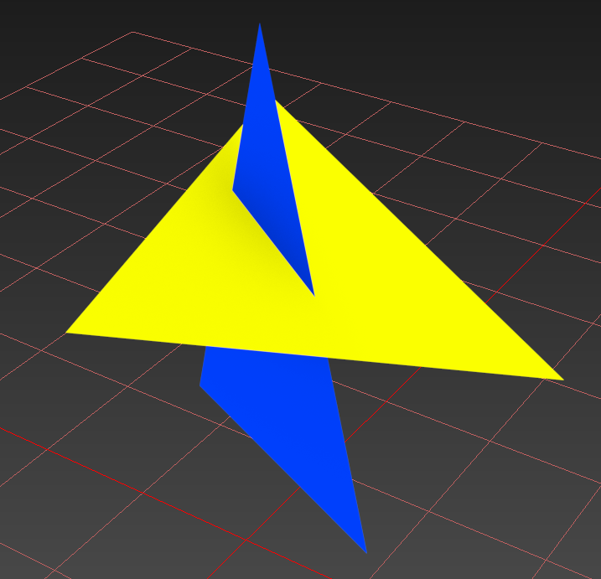
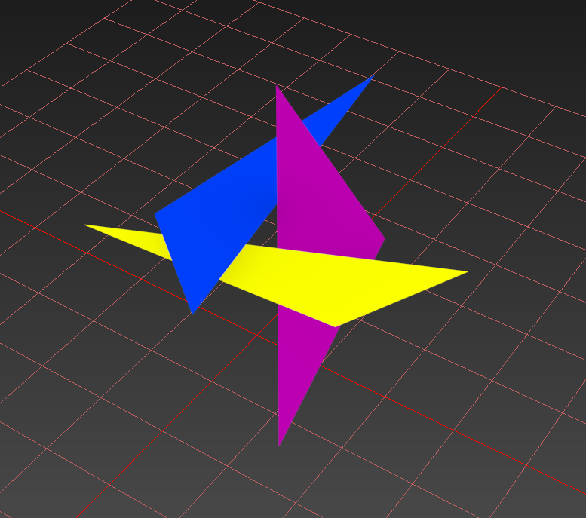
The Painter’s Algorithm: Edge Cases

Slide 6

The Z Buffer Algorithm
Screen X
Cartesian Z
Screen Y
FRONT VIEW
CROSS SECTION

Slide 7
Sorting your pixels by depth
Pros
Cons
Per-Pixel Accuracy!
Great for highly dynamic environments!
Handles all pervious edges cases!
Straightforward addition to a rasterizer.
Speed! Fast to accept or reject new pixels!
Did I mention not sorting your primitives!?
More memory. (One depth per pixel)
Depth Buffer must be cleared every frame.
Only works on opaque geometry.
Transparent objects must still be Z sorted.

Slide 8
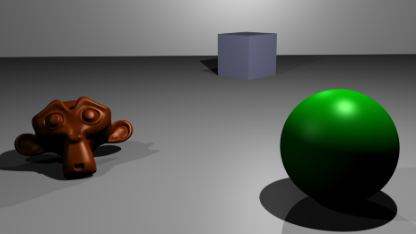
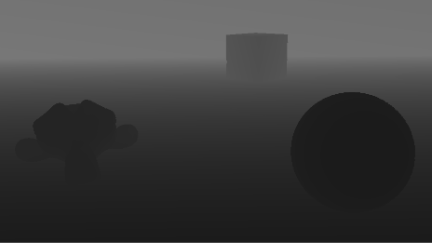
Z Buffer Visualized
Color Buffer X8R8G8B8
Depth Buffer Float32

Slide 9
Implementing a Z Buffer
Step 1: Allocate a buffer of floating point information the same size as your frame buffer. This will be your “Z Buffer” a.k.a “Depth Buffer”.
Each float represents the current Z of the matching pixel on the screen.
Step 2: During rasterization compute the interpolated Z for any new pixel you wish to draw to the screen. (Linear for Lines, Barycentric for Triangles)
Now we actually have a use for those Z coordinates!
Step 3: Compare the “new depth” to the “existing depth” of the overlapping pixel that is currently stored in the “Z Buffer”.
You can modify your “Plot Pixel” pixel function to accept a depth value.
Step 4: If the new pixel is closer than the old one then keep it. Otherwise reject it!
Don’t forget to Clear the Z buffer before every new frame! (Hmm… clear it to what?)

Slide 10
Types of Depth Buffers
Linear Z
Exponential Z (Z/W)
Goes from Zero to the Far Plane.
Linear depth precision.
Better than exponential for distant pixels.
Not as precise up close where you need it.
Not affected by tiny Near Plane distances.
Always Zero to One
Precision drops off exponentially.
Very accurate up close.
Loss of precision is usually acceptable for distant pixels.
Sensitive to tiny Near Plane distances, push it forward as far as you can tolerate.
The Standard! Used by most 3D Hardware.

Slide 11
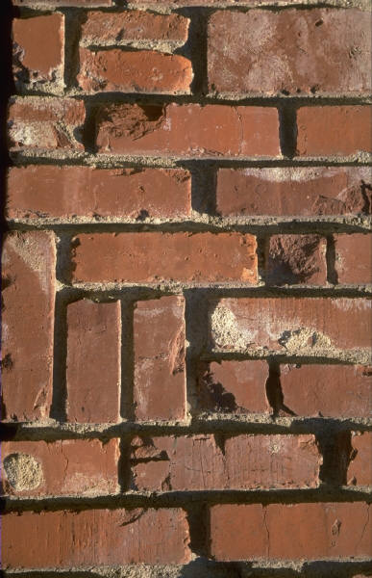
Texture Mapping

Slide 12
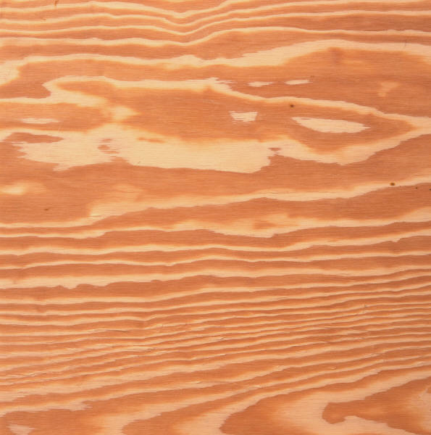
Texture Coordinates
U Axis
( 0, 0 )
( 1, 0 )
Often referred to as UV Coordinates, U is a horizontal measure of Ratio across an image while V is the vertical Ratio.
Using a Ratio is preferable to pixel coordinates because it allows us more flexibility if we later decide to change the resolution of our image.
A pixel described in terms of UV is known as a “Texel”.
( 0.5, 0.5 )
V Axis
( 0, 1 )
( 1, 1 )

Slide 13
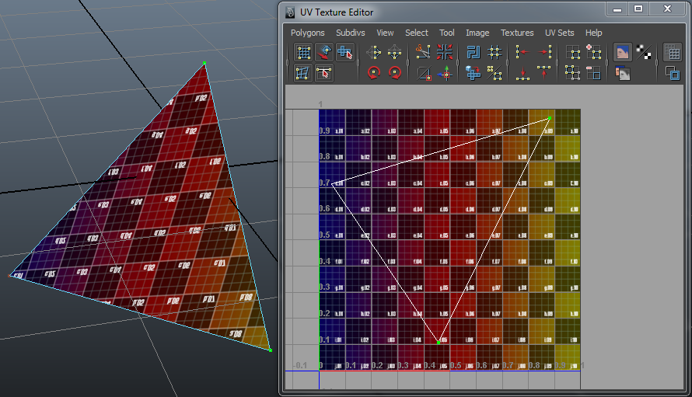
UV Data & Triangles
By adding UV data to your vertex structure you can describe how a 2D image “falls” across the surface of a specific triangle.
By adding multiple triangles each showing a different part of the texture, the entire image is revealed (mapped) across a 3D shape.
Remember: A UV is a Texture Coordinate! A location of a color!

Slide 14

Rasterization: Finding the “Texel” of a Pixel
0.4u, 0.9v
Texture Mapping is a per-pixel operation. We need to color each pixel based on what part of the 2D image is supposed to be covering a specific pixel.
Unfortunately we only know the “Texels” of the three vertices, not any of the pixels themselves…
Good news! We have already solved this problem when dealing with color!
Solution: Barycentric Interpolation!
0.32u, 0.301v
0.1u, 0.3v
0.9u, 0.1v
FINDING PIXEL TEXELS

Slide 15
Implementing 2D Texturing for Triangles
Step 1: Add UV coordinates to your Vertex structure.
Use values between 0 – 1 when filling them out. (Ratios!)
Step 2: In the same way that you did your Z coordinate, interpolate your UVs across the surface of the triangle. (Interpolation is great isn’t it?)
Step 3: Pass the interpolated UV to a custom pixel shader.
Pixel Shaders should be called before plotting any pixel to determine color.
Step 4: In the Pixel Shader convert the UV or “Texel” to an actual pixel XY that resides on the 2D texture of your choice. This will be the final color of the new Pixel.
Remember that a UV is in the form of a Ratio, you will need to know the texture’s dimensions.

Slide 16
Pixel Shaders: Texturing Pipeline
PixelShaderBrick(…)
TEXEL UV
PIXEL XY
DrawTriangle(…)
TEXTURE PIXELS

Slide 17

Recap: For Lab
INTERPOLATE!
ALL THE THINGS!!!

Slide 18
Applicable Reading Assignment
For next time read:
In Chapter 8 The Graphics Pipeline:
Read section 8.3 – 8.4
In Chapter 11 Texture Mapping
Read sections 11.3 – 11.7
In Chapter 12 Data Structures for Graphics:
Read section 12.2

